Slide 1
CSE2101: Object Oriented Programming-II (Java)
Lecture 10

Slide 2
Java Swing

Slide 3
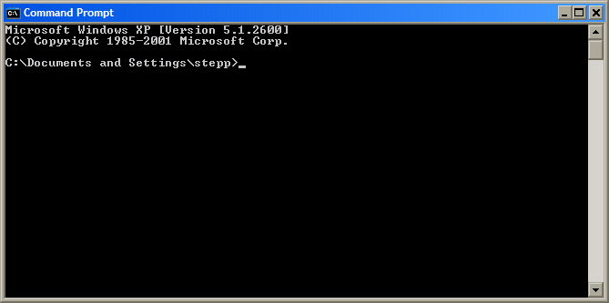
Motivation
Learn how to create a graphical user interface (GUI) using Java and Swing
Understand Java graphical component hierarchy
Learn Java's event-driven model
Banish the evil black box to the fiery depths from which it came

Slide 4
Java GUI: AWT and Swing
Sun’s initial idea: create a set of classes/methods that can be used to write a multi-platform GUI (Abstract Windowing Toolkit, or AWT)
problem: not powerful enough; limited; a bit clumsy to use
Second edition (JDK v1.2): Swing
a newer library written from the ground up that allows much more powerful graphics and GUI construction
Drawback: Both exist in Java now; easy to get them mixed up; still have to use both sometimes!

Slide 5
Swing and AWT components - a quick Reminder
Mix Swing and AWT components as little as possible (not at all in most cases)
Put ‘J’ in front of everything AWT provides to get Swing’s counterpart
AWT: Button
Swing: JButton

Slide 6
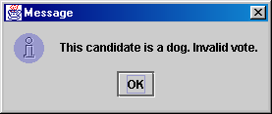
Simplest GUI programming: JOptionPane
An option pane is a simple dialog box for graphical input/output
advantages:
simple
flexible (in some ways)
looks better than the black box of doom
disadvantages:
created with static methods; not very object-oriented
not very powerful (just simple dialog boxes)

Slide 7
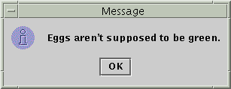
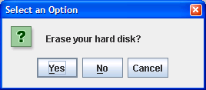
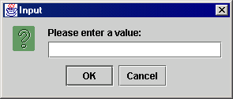
Types of JOptionPane
public static void showMessageDialog( Component parent, Object message) Displays a message on a dialog with an OK button.
public static int showConfirmDialog( Component parent, Object message) Displays a message and list of choices Yes, No, Cancel
public static String showInputDialog( Component parent, Object message) Displays a message and text field for input, and returns the value entered as a String.

Slide 8
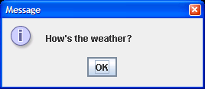
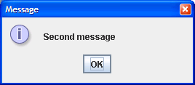
JOptionPane examples 1
showMessageDialog analogous to System.out.println for displaying a simple message
import javax.swing.*;
class MessageDialogExample {
public static void main(String[] args) {
JOptionPane.showMessageDialog(null, "How's the weather?");
JOptionPane.showMessageDialog(null, "Second message");
}
}

Slide 9
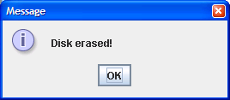
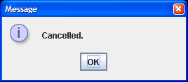
JOptionPane examples 2
showConfirmDialog analogous to a System.out.print that prints a question, then reading an input value from the user (can only be one of the provided choices)
import javax.swing.*;
class ConfirmDialogExample {
public static void main(String[] args) {
int choice = JOptionPane.showConfirmDialog(null,
"Erase your hard disk?");
if (choice == JOptionPane.YES_OPTION) {
JOptionPane.showMessageDialog(null, "Disk erased!");
} else {
JOptionPane.showMessageDialog(null, "Cancelled.");
}
}
}

Slide 10
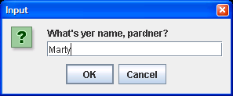
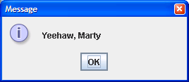
JOptionPane examples 3
showInputDialog analogous to a System.out.print that prints a question, then reading an input value from the user (can be any value)
import javax.swing.*;
class InputDialogExample {
public static void main(String[] args) {
String name = JOptionPane.showInputDialog(null,
"What's yer name, pardner?");
JOptionPane.showMessageDialog(null, "Yeehaw, " + name);
}
}

Slide 11

Onscreen GUI elements
windows: actual first-class citizens of desktop; also called top-level containers examples: frame, dialog box
components: GUI widgets examples: button, text box, label
containers: logical grouping for components example: panel

Slide 12
Swing Component Hierarchy
java.lang.Object
+--java.awt.Component
+--java.awt.Container
|
+--javax.swing.JComponent
| +--javax.swing.JButton
| +--javax.swing.JLabel
| +--javax.swing.JMenuBar
| +--javax.swing.JOptionPane
| +--javax.swing.JPanel
| +--javax.swing.JTextArea
| +--javax.swing.JTextField
|
+--java.awt.Window
+--java.awt.Frame
+--javax.swing.JFrame
import java.awt.*; import javax.swing.*;

Slide 13
Components and Containers
Components
The building blocks
Variety of uses and complexities
Containers
The cement
Hierarchical organisation
Distinction is not always drawn

Slide 14
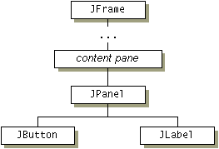
Containment hierarchies
Top level containers
Intermediate containers
Atomic components

Slide 15
Top-level containers
At the root of every containment hierarchy
All Swing programs have at least one
Content panes
Types of top-level containers
Frames
Dialogs
Applets

Slide 16
Top Level Container (Frame)
//this won’t compile…
public static void main(String[] args)
{
JFrame frame = new JFrame(“A JFrame"); //Just like any //other class
// do things with frame
frame.setJMenuBar(menuBar);
frame.setContentPane(contentPane);
frame.setDefaultCloseOperation(JFrame.EXIT_ON_CLOSE);
// set frame size
frame.pack();
// realize frame
frame.setVisible(true);
} // end main

Slide 17
Dialog boxes
More limited than frames
Modality
Types of dialogs
JOptionPane
ProgressMonitor
JColorChooser
JDialog

Slide 18
GUI Component API
Java: GUI component = class
Properties
Methods
Events
JButton

Slide 19
Using a GUI Component
Create it
Instantiate object: b = new JButton(“press me”);
Configure it
Properties: b.text = “press me”; [avoided in java]
Methods: b.setText(“press me”);
Add it
panel.add(b);
Listen to it
Events: Listeners
JButton

Slide 20
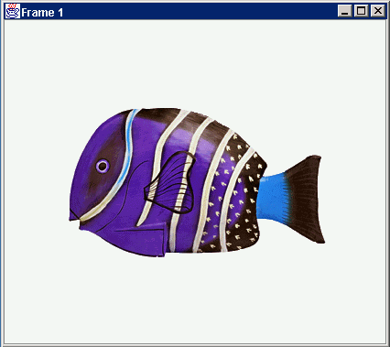
Anatomy of an Application GUI
GUI
Internal structure
JFrame
JFrame
JPanel
containers
JPanel
JButton
JButton
JLabel
JLabel

Slide 21
Using a GUI Component 2
Create it
Configure it
Add children (if container)
Add to parent (if not JFrame)
Listen to it
order important

Slide 22
Build from bottom up
Listener
Create:
Frame
Panel
Components
Listeners
Add: (bottom up)
listeners into components
components into panel
panel into frame
JLabel
JButton
JPanel
JFrame

Slide 23
Code
JFrame f = new JFrame(“title”);
JPanel p = new JPanel( );
JButton b = new JButton(“press me”);
p.add(b); // add button to panel
f.setContentPane(p); // add panel to frame
f.show();
press me

Slide 24
Application Code
import javax.swing.*;
class hello {
public static void main(String[] args){
JFrame f = new JFrame(“title”);
JPanel p = new JPanel();
JButton b = new JButton(“press me”);
p.add(b); // add button to panel
f.setContentPane(p); // add panel to frame
f.setvisible(true);
}
}
press me

Slide 25
Methods of all Swing components
public int getWidth() public int getHeight() Allow access to the component's current width and height in pixels.
public boolean isEnabled() Returns whether the component is enabled (can be interacted with).
public boolean isVisible() Returns whether the component is visible (can be seen on the screen).

Slide 26
More JComponent methods
public void setBackground(Color c) Sets the background color of the component to be the given color.
public void setFont(Font f) Sets the font of the text on the given component to be the given font.
public void setEnabled(boolean b) Sets whether the component is enabled (can be interacted with).
public void setVisible(boolean b) Sets whether the component is visible (can be seen on the screen). Set to true to show the component, or set to false to hide the component.

Slide 27
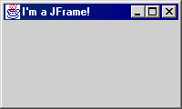
JFrame
A frame is a graphical window that can be used to hold other components
public JFrame() or public JFrame(String title) Creates a frame with an optional title.
public void setTitle(String text) Puts the given text in the frame’s title bar.
public void setDefaultCloseOperation(int op) Makes the frame perform the given action when it closes. Common value: JFrame.EXIT_ON_CLOSE
public void add(Component comp) Places the given component or container inside the frame.
How would we add more than one component to the frame?
public void pack() Resizes the frame to fit the components inside it.
NOTE: Call setVisible(true) to make a frame appear on the screen after creating it.

Slide 28
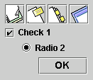
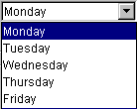





Atomic components (1)
Buttons
Combo boxes
Lists
Menus
Sliders
Text Fields
Labels

Slide 29

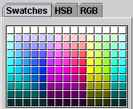

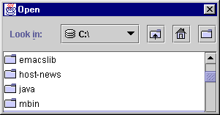
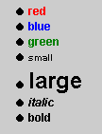
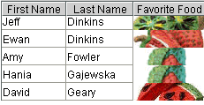

Atomic Components (2)
Tool tips
Progress bars
Colour choosers
File choosers
Tables
Text
Trees

Slide 30
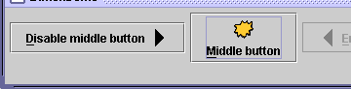
JButton, JLabel
The most common component— a button is a clickable onscreen region that the user interacts with to perform a single command
A text label is simply a string of text displayed on screen in a graphical program. Labels often give infor- mation or describe other components
public JButton(String text) public JLabel(String text) Creates a new button / label with the given string as its text.
public String getText() Returns the text showing on the button / label.
public void setText(String text) Sets button / label's text to be the given string.

Slide 31
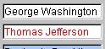

JTextField, JTextArea
A text field is like a label, except that the text in it can be edited and modified by the user. Text fields are commonly used for user input, where the user types information in the field and the program reads it
A text area is a multi-line text field
public JTextField(int columns)
public JTextArea(int lines, int columns) Creates a new text field that is the given number of columns (letters) wide.
public String getText() Returns the text currently in the field.
public void setText(String text) Sets field's text to be the given string.

Slide 32
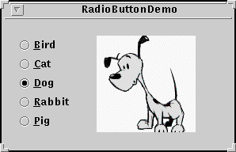
JCheckBox, JRadioButton
A check box is a toggleable button with two states: checked and unchecked
A radio button is a button that can be selected; usually part of a group of mutually-exclusive radio buttons (1 selectable at a time)
public JCheckBox / JRadioButton(String text) public JCheckBox(String text, boolean isChecked) Creates checked/unchecked check box with given text.
public boolean isSelected() Returns true if check box is checked.
public void setSelected(boolean selected) Sets box to be checked/unchecked.

Slide 33
ButtonGroup
A logical group of radio buttons that ensures that only one is selected at a time
public ButtonGroup()
public void add(JRadioButton button)
The ButtonGroup is not a graphical component, just a logical group; the RadioButtons themselves are added to the container, not the ButtonGroup

Slide 34
Problem: positioning, resizing
How does the programmer specify where each component sits in the window, how big each component should be, and what the component should do if the window is resized/moved/maximized/etc?
Absolute positioning (C++, C#, others): Specify exact pixel coordinates for every component
Layout managers (Java): Have special objects that decide where to position each component based on some criteria

Slide 35
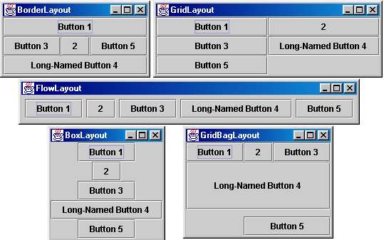
Containers with layout
The idea: Place many components into a container(s), then add the container(s) to the JFrame

Slide 36
Container
A container is an object that holds components; it also governs their positions, sizes, and resize behavior
public void add(Component comp) public void add(Component comp, Object info) Adds a component to the container, possibly giving extra information about where to place it.
public void remove(Component comp) Removes the given component from the container.
public void setLayout(LayoutManager mgr) Uses the given layout manager to position the components in the container.
public void validate() You should call this if you change the contents of a container that is already on the screen, to make it re-do its layout.

Slide 37
JPanel
A panel is our container of choice; it inherits the methods from the previous slide and defines these additional methods (among others):
public JPanel() Constructs a panel with a default flow layout.
public JPanel(LayoutManager mgr) Constructs a panel that uses the given layout manager.

Slide 38

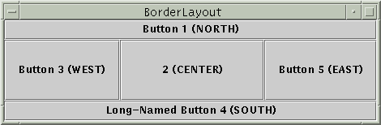
Preferred size of components
Swing component objects each have a certain size they would "like" to be--just large enough to fit their contents (text, icons, etc.)
This is called the preferred size of the component
Some types of layout managers (e.g. FlowLayout) choose to size the components inside them to the preferred size; others (e.g. BorderLayout, GridLayout) disregard the preferred size and use some other scheme
Buttons at preferred size: Not preferred size:

Slide 39
BorderLayout
public BorderLayout()
divides container into five regions: NORTH, SOUTH, WEST, EAST, CENTER
NORTH and SOUTH regions expand to fill region horizontally, and use preferred size vertically
WEST and EAST regions expand to fill region vertically, and use preferred size horizontally
CENTER uses all space not occupied by others
Container panel = new JPanel(new BorderLayout());
panel.add(new JButton("Button 1 (NORTH)", BorderLayout.NORTH);

Slide 40
FlowLayout
public FlowLayout()
treats container as a left-to-right, top-to-bottom "page" or "paragraph"
components are given their preferred size both horizontally and vertically
components are positioned in order added
if too long, components wrap around to next line
Container panel = new JPanel(new FlowLayout());
panel.add(new JButton("Button 1"));

Slide 41
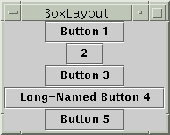
BoxLayout
Box.createHorizontalBox()
Box.createVerticalBox()
aligns components in container in a single row or column
components use preferred sizes and align based on their preferred alignment
preferred way to construct a container with box layout: Box.createHorizontalBox(); or Box.createVerticalBox();

Slide 42
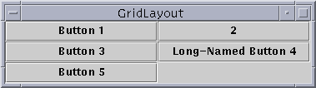
GridLayout
Grid of cells - all same size
Components take all space in a cell
Gaps
default = 5
use setter methods hGap and vGap
or via arguments to constructor
Re-sizing
Cells resize to be as large as possible in given window / container

Slide 43
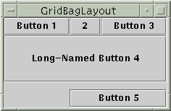
GridBagLayout (1)
Very flexible (and complex!)
Rows can have different heights
Columns can have different lengths
Uses cells in a grid
GridBagLayout gridbag = new GridBagLayout();
GridBagConstraints c = new GridBagConstraints();
JPanel pane = new JPanel();
pane.setLayout(gridbag);
//--- For each component to be added to this container:
//--- ...Create the component...
//--- ...Set instance variables in the GridBagConstraints instance...
gridbag.setConstraints(theComponent, c);
pane.add(theComponent);

Slide 44
GridBagLayout (2)
Constraints
set in an instance of a gridBagConstraints Object
gridx and gridy - The row and column of the upper
left of the component
Anchor - Where to display within cell when component
is smaller than it
fill - How to size component when cell is larger than components requested size
insets - External padding - min space between component and cell edges
ipadx, ipady - Internal padding - What to add to min size of components
weightx and weighty - How to distribute extra space (padding)
gridwidth and gridheight - Number of columns or rows the component uses
Example explained very well here:
http://java.sun.com/docs/books/tutorial/uiswing/layout/gridbagExample.html

Slide 45

CardLayout
Manages objects (usually JPanels) in sets
Works much like tabbed pane
Choose cards by
Asking for card in order added to container
Going backwards or forwards
Specifying card by name

Slide 46
Choosing Layout Managers (1)
In order to display a component in as much space as it can get, consider:
BorderLayout
Component in centre
GridBagLayout
fill=GridBagConstraints.BOTH
BoxLayout
Component specifies very large preferred/maximum sizes

Slide 47
Choosing Layout Managers (2)
To display a few components in a compact row:
JPanel’s default FlowLayout
BoxLayout
Display a few components of the same size in rows and columns
GridLayout

Slide 48
Choosing layout managers (3)
Display a few components in a row or column, with different spacing between them and custom component sizes
BoxLayout
Display a complex layout that has many components
GridBagLayout
Using JPanel grouping and hierarchies

Slide 49
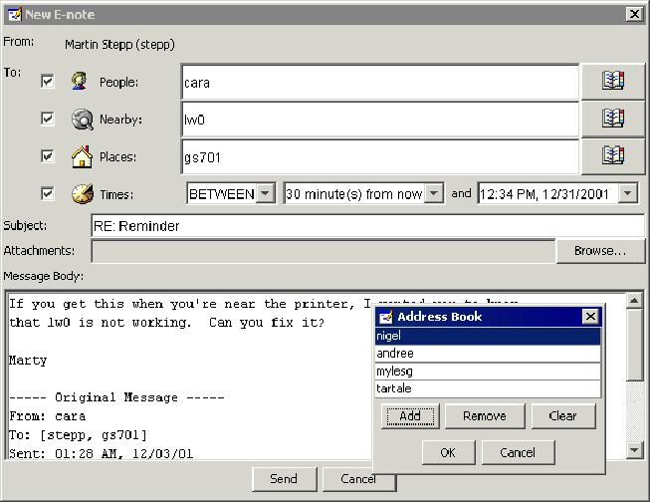
Problem with Layout Managers
How would you create a complex window like this, using the layout managers shown?

Slide 50
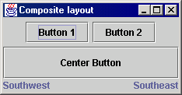
Solution: composite layout
create panels within panels
each panel has a different layout, and by combining the layouts, more complex / powerful layout can be achieved
example:
how many panels?
what layout in each?

Slide 51
Event-driven Programming
program’s execution is indeterminate
on-screen components cause events to occur when they are clicked / interacted with
events can be handled, causing the program to respond, driving the execution thru events (an "event-driven" program)

Slide 52
Java Event Hierarchy
java.lang.Object
+--java.util.EventObject
+--java.awt.AWTEvent
+--java.awt.event.ActionEvent
+--java.awt.event.TextEvent
+--java.awt.event.ComponentEvent
+--java.awt.event.FocusEvent
+--java.awt.event.WindowEvent
+--java.awt.event.InputEvent
+--java.awt.event.KeyEvent
+--java.awt.event.MouseEvent
import java.awt.event.*;

Slide 53
Some typical component events and listeners
Act that results in event | Listener
User clicks a button, presses return while typing in a text field, or chooses a menu item | ActionListener
User closes a window | WindowListener
User presses a mouse button while the cursor is over a component | MouseListener
User moves the mouse over a component | MouseMotionListener
Component becomes visible | ComponentListener
Component gets the keyboard focus | FocusListener
Table or list selection changes | ListSelectionListener

Slide 54

Listening for Events
attach listener to component
listener’s appropriate method will be called when event occurs (e.g. when the button is clicked)
for Action events, use ActionListener

Slide 55
Writing an ActionListener
// part of Java; you don’t write this
public interface ActionListener {
void actionPerformed(ActionEvent event);
}
// Prints a message when the button is clicked.
public class MyActionListener implements ActionListener {
public void actionPerformed(ActionEvent event){
System.out.println("Event occurred!");
}
}

Slide 56
Attaching an ActionListener
JButton button = new JButton("button 1");
ActionListener listener = new MyActionListener();
button.addActionListener(listener);
now button will print "Event occurred!" when clicked
addActionListener method exists in many Swing components

Slide 57
References
The Java Tutorial: Visual Index to the Swing Components. https://docs.oracle.com/javase/tutorial/uiswing/components/index.html
The Java Tutorial: Laying Out Components Within a Container. https://docs.oracle.com/javase/tutorial/uiswing/layout/index.html
The Java Tutorial: How to Write Action Listeners. https://docs.oracle.com/javase/tutorial/uiswing/events/actionlistener.html

Slide 58
Thank you

